Slide 1
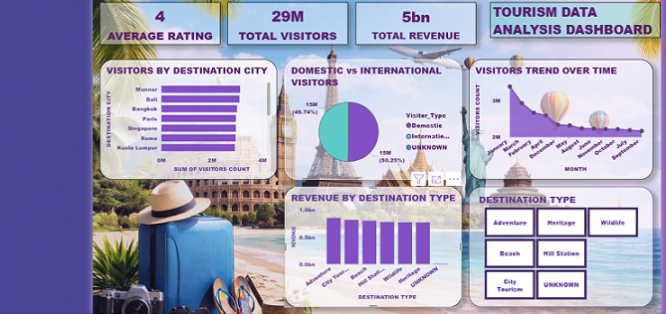
TOURISM TREND ANALYSIS AND VISITOR FORECASTING ACROSS REGIONS

Slide 2
INTRODUCTION
A Data-Driven Approach to Understand Tourism Trends
Analyze tourism data to identify travel patterns
Understand seasonal variations in tourist flow
Evaluate revenue generated from tourism
Identify factors influencing tourist decisions
Provide insights for better tourism planning and development

Slide 3
PROJECT OBJECTIVE
Analyze tourism data
Identify popular destinations
Understand seasonal trends
Study revenue patterns

Slide 4
PROJECT WORKFLOW
Data Loading and Initial Overview
Data Pre-Processing
Exploratory Data Analysis
Visualizations
Insights Generation And Report

Slide 5
TOOLS USED
Python
Pandas
NumPy
Plotly

Slide 6
DATASET OVERVIEW
Number of Rows -12,000
Number of Columns- 11
Variables Includes:
• Locations
• Tourist Count
• Revenue
• Seasons
• Tourism Type

Slide 7
STEP 1: DATA LOADING
Imported required libraries (Pandas, NumPy)
Loaded dataset using CSV file
Read data into a DataFrame
Verified dataset structure (rows & columns)
Checked first few records using head()
Reviewed column names and data types
Ensured data was loaded correctly for analysis

Slide 8
STEP 2: DATA PRE-PROCESSING
Handling Missing Values
Remove Duplicates
Converting Data Type
Creating Derived Columns
Filtering Or Aggregation

Slide 9
STEP 3: EXPLORATORY DATA ANALYSIS(EDA)
Univariate Analysis
Bivariate Analysis
Multivariate Analysis
Group By Analysis
Pivot Table
Statistical Summaries
Correlation Heatmap

Slide 10
STEP 4: VISUALIZATIONS
Bar Plot(Visitors By Season)
Stacked Bar Chart(Visitors by Season and Visitor Type)
Line Chart(Visitors Trend)
Pie Chart (Distribution of Destination Types)
Histogram (Average Spending Distribution)
Box Plot (Spending By Season)
Subplot(Visitors Count by Destination Type Across Seasons)
Scatter Plot (Visitors Count vs Revenue)
Heatmap (Correlation between Visitors Count and Average Spending)

Slide 11
STEP 5: INSIGHTS
Peak seasons drive maximum tourism
Popular destinations dominate visits
Revenue follows tourist trends
Off-season shows low activity
Seasonal patterns impact travel

Slide 12
RECOMMENDATIONS
Promote tourism during off-season to balance visitor flow
Improve infrastructure in low-performing destinations
Focus marketing on high-potential locations
Introduce seasonal offers and travel packages
Enhance tourist experience through better facilities
Use data-driven strategies for tourism planning
Encourage sustainable and eco-friendly tourism

Slide 13
CONCLUSION
Tourism trends were successfully analyzed using data
Key patterns in tourist flow and seasonal variation were identified
Popular and underperforming destinations were recognized
Insights help in improving tourism planning and strategies
Data-driven decisions can enhance overall tourism growth

Slide 14
THANK YOU

